Slide 1
C++ Programming:
From Problem Analysis to Program Design, Fourth Edition
Chapter 4: Control Structures I (Selection)

Slide 2
Objectives
In this chapter, you will:
Learn about control structures
Examine relational and logical operators
Explore how to form and evaluate logical (Boolean) expressions
Discover how to use the selection control structures if, if...else, and switch in a program
Learn to use the assert function to terminate a program
C++ Programming: From Problem Analysis to Program Design, Fourth Edition

Slide 3
Control Structures
A computer can proceed:
  In sequence
  Selectively (branch) - making a choice
  Repetitively (iteratively) - looping
Some statements are executed only if certain conditions are met
A condition is met if it evaluates to true
C++ Programming: From Problem Analysis to Program Design, Fourth Edition

Slide 4
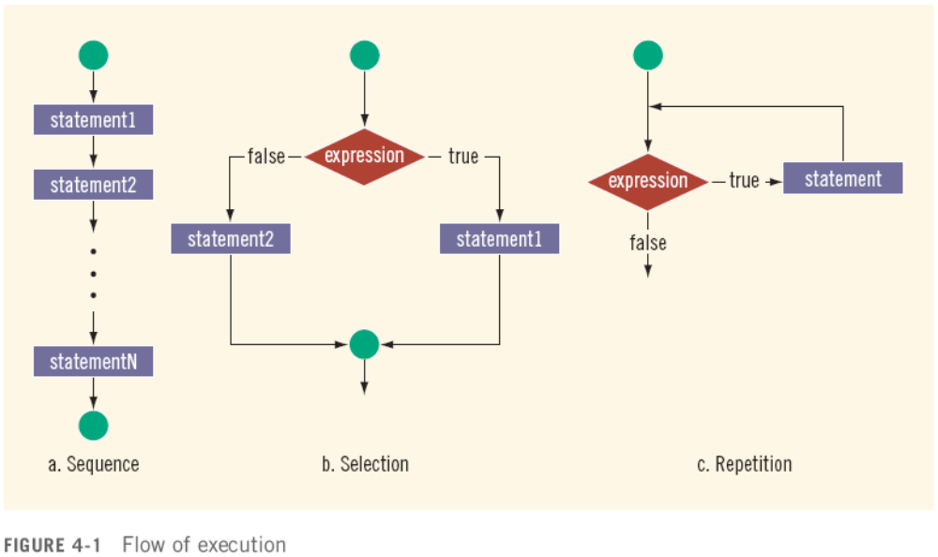
Control Structures (continued)
C++ Programming: From Problem Analysis to Program Design, Fourth Edition

Slide 5
Relational Operators
A condition is represented by a logical (Boolean) expression that can be true or false
Relational operators:
  Allow comparisons
  Require two operands (binary)
  Evaluate to true or false
C++ Programming: From Problem Analysis to Program Design, Fourth Edition

Slide 6
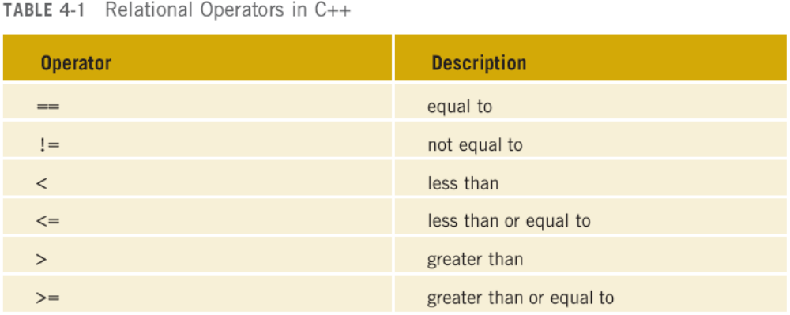
Relational Operators (continued)
C++ Programming: From Problem Analysis to Program Design, Fourth Edition

Slide 7
Relational Operators and Simple Data Types
You can use the relational operators with all three simple data types:
  8 < 15 evaluates to true
  6 != 6 evaluates to false
  2.5 > 5.8 evaluates to false
  5.9 <= 7.5 evaluates to true
C++ Programming: From Problem Analysis to Program Design, Fourth Edition

Slide 8
Comparing Floating-Point Numbers for Equality
Comparison of floating-point numbers for equality may not behave as you would expect
  Example:
    1.0 == 3.0/7.0 + 2.0/7.0 + 2.0/7.0 evaluates to false
    Why? 3.0/7.0 + 2.0/7.0 + 2.0/7.0 = 0.99999999999999989
Solution: use a tolerance value
  Example: fabs(x – y) < 0.000001
C++ Programming: From Problem Analysis to Program Design, Fourth Edition

Slide 9
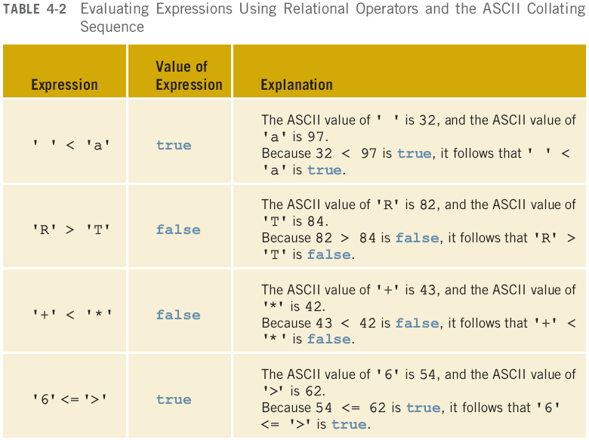
Comparing Characters
C++ Programming: From Problem Analysis to Program Design, Fourth Edition

Slide 10
Relational Operators and the string Type
Relational operators can be applied to strings
Strings are compared character by character, starting with the first character
Comparison continues until either a mismatch is found or all characters are found equal
If two strings of different lengths are compared and the comparison is equal to the last character of the shorter string
  The shorter string is less than the larger string
C++ Programming: From Problem Analysis to Program Design, Fourth Edition

Slide 11
Relational Operators and the string Type (continued)
Suppose we have the following declarations:
  string str1 = "Hello";
  string str2 = "Hi";
  string str3 = "Air";
  string str4 = "Bill";
  string str4 = "Big";
C++ Programming: From Problem Analysis to Program Design, Fourth Edition

Slide 12
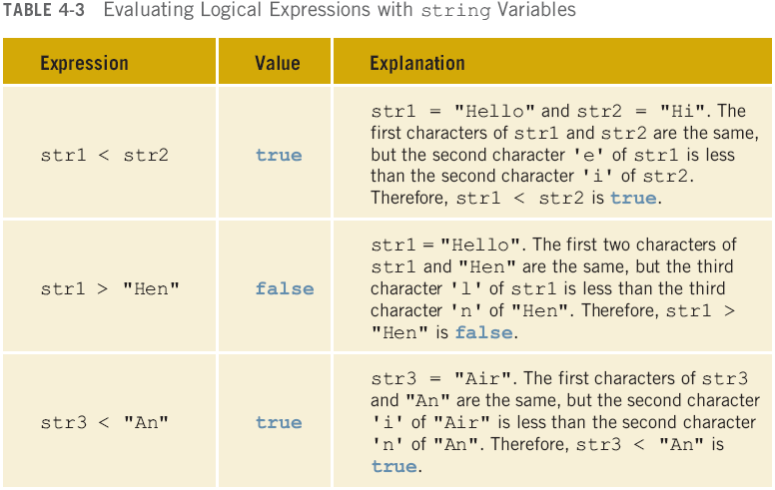
Relational Operators and the string Type (continued)
C++ Programming: From Problem Analysis to Program Design, Fourth Edition

Slide 13
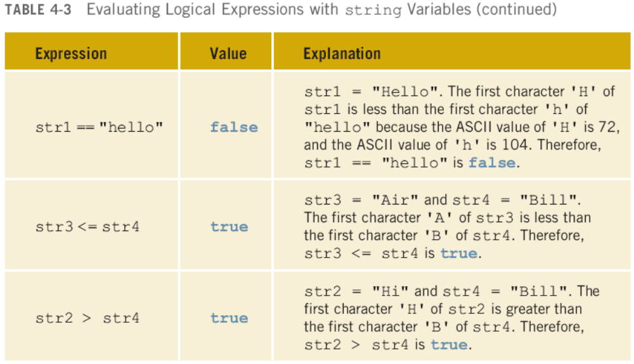
Relational Operators and the string Type (continued)
C++ Programming: From Problem Analysis to Program Design, Fourth Edition

Slide 14
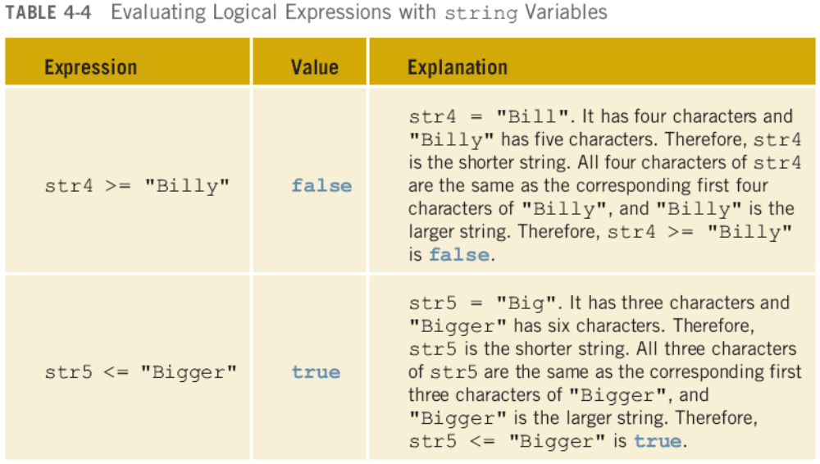
Relational Operators and the string Type (continued)
C++ Programming: From Problem Analysis to Program Design, Fourth Edition

Slide 15
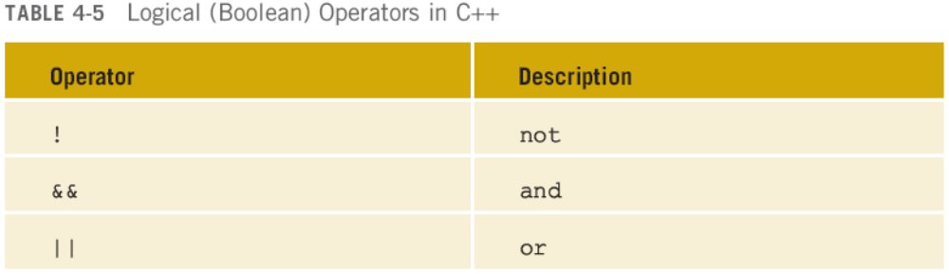
Logical (Boolean) Operators and Logical Expressions
Logical (Boolean) operators enable you to combine logical expressions
unary
binary
binary
C++ Programming: From Problem Analysis to Program Design, Fourth Edition

Slide 16
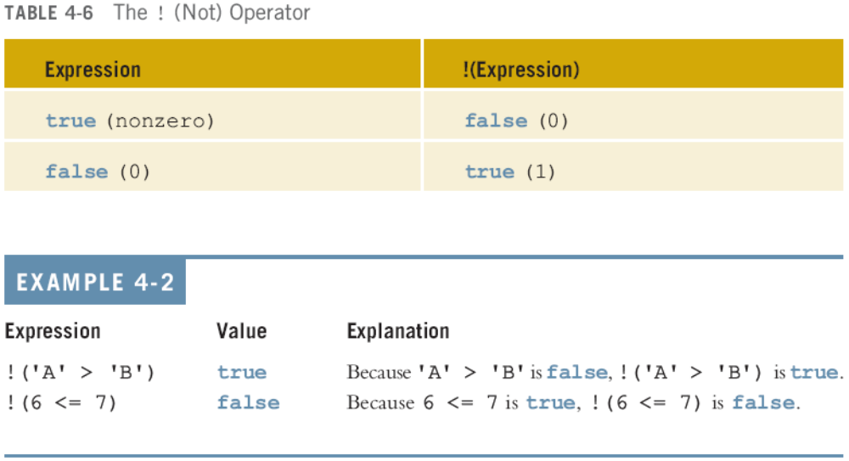
Logical (Boolean) Operators and Logical Expressions (continued)
C++ Programming: From Problem Analysis to Program Design, Fourth Edition

Slide 17
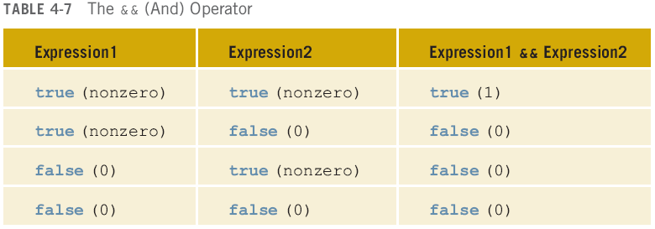
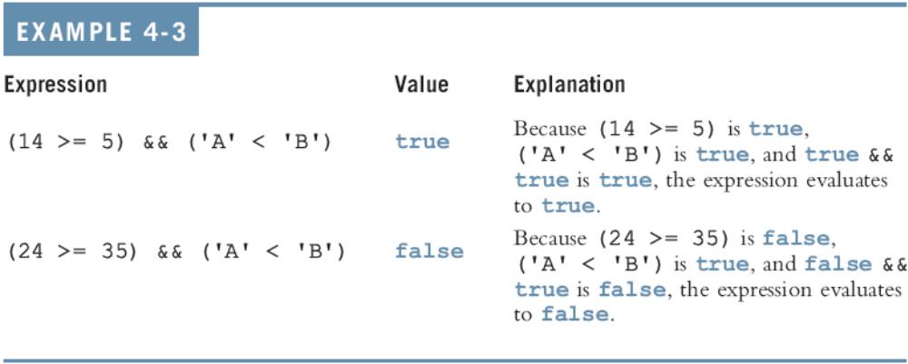

Slide 18
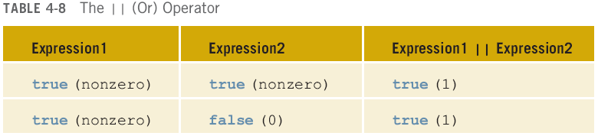
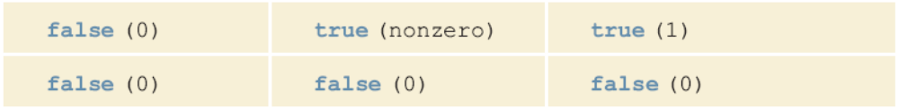
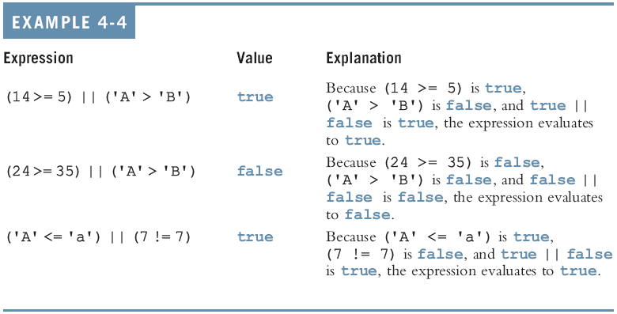

Slide 19
Order of Precedence
Relational and logical operators are evaluated from left to right
The associativity is left to right
Parentheses can override precedence
C++ Programming: From Problem Analysis to Program Design, Fourth Edition

Slide 20
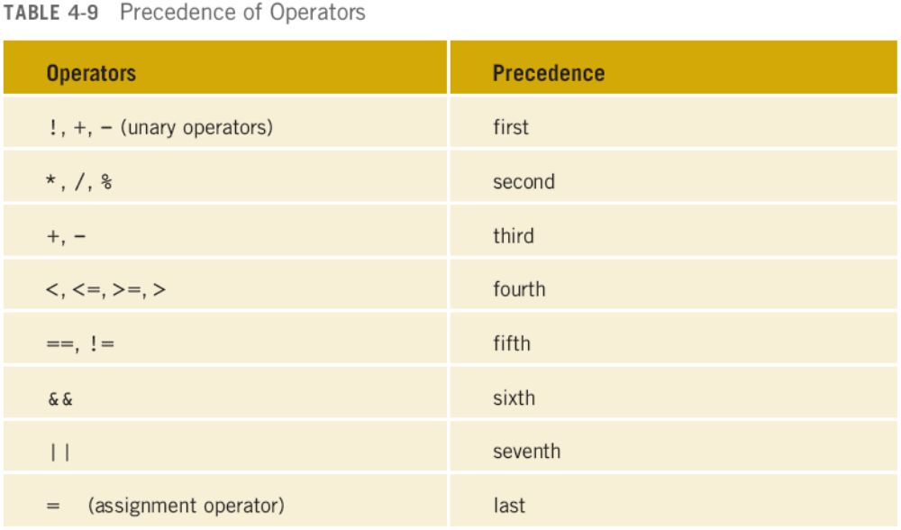
Order of Precedence (continued)
C++ Programming: From Problem Analysis to Program Design, Fourth Edition

Slide 21
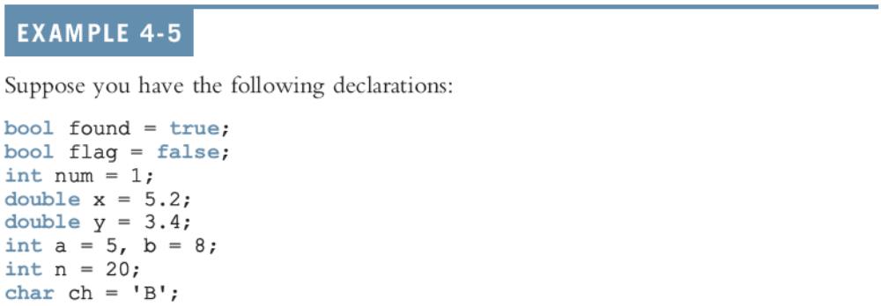
Order of Precedence (continued)
C++ Programming: From Problem Analysis to Program Design, Fourth Edition

Slide 22
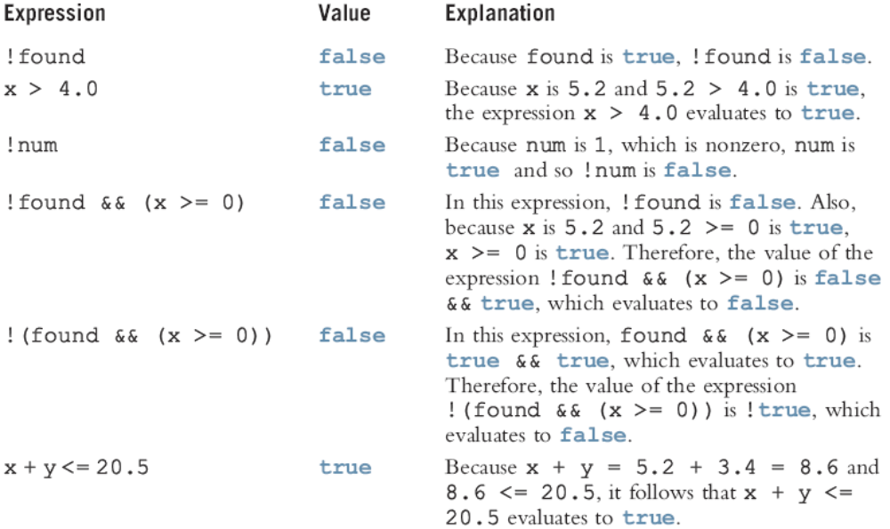
Order of Precedence (continued)
C++ Programming: From Problem Analysis to Program Design, Fourth Edition

Slide 23
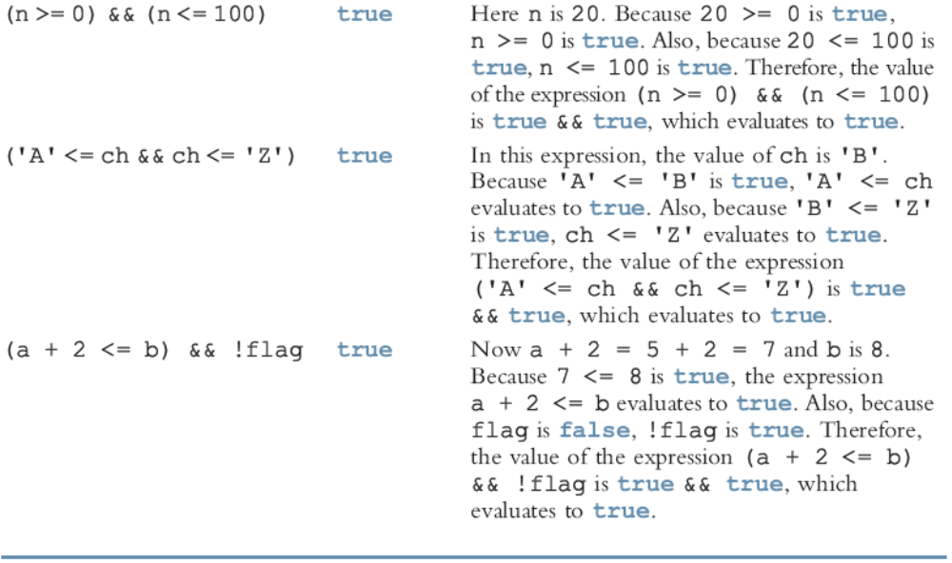
Order of Precedence (continued)
C++ Programming: From Problem Analysis to Program Design, Fourth Edition

Slide 24
Short-Circuit Evaluation
Short-circuit evaluation: evaluation of a logical expression stops as soon as the value of the expression is known
Example:
(age >= 21) || ( x == 5) //Line 1
(grade == 'A') && (x >= 7) //Line 2
C++ Programming: From Problem Analysis to Program Design, Fourth Edition

Slide 25
int Data Type and Logical (Boolean) Expressions
Earlier versions of C++ did not provide built-in data types that had Boolean values
Logical expressions evaluate to either 1 or 0
  The value of a logical expression was stored in a variable of the data type int
You can use the int data type to manipulate logical (Boolean) expressions
C++ Programming: From Problem Analysis to Program Design, Fourth Edition

Slide 26
The bool Data Type and Logical (Boolean) Expressions
The data type bool has logical (Boolean) values true and false
bool, true, and false are reserved words
The identifier true has the value 1
The identifier false has the value 0
C++ Programming: From Problem Analysis to Program Design, Fourth Edition

Slide 27
Logical (Boolean) Expressions
Logical expressions can be unpredictable
The following expression appears to represent a comparison of 0, num, and 10:
0 <= num <= 10
It always evaluates to true because 0 <= num evaluates to either 0 or 1, and 0 <= 10 is true and 1 <= 10 is true
A correct way to write this expression is:
0 <= num && num <= 10
C++ Programming: From Problem Analysis to Program Design, Fourth Edition

Slide 28
Selection: if and if...else
One-Way Selection
Two-Way Selection
Compound (Block of) Statements
Multiple Selections: Nested if
Comparing if...else Statements with a Series of if Statements
C++ Programming: From Problem Analysis to Program Design, Fourth Edition

Slide 29
Selection: if and if...else (continued)
Using Pseudocode to Develop, Test, and Debug a Program
Input Failure and the if Statement
Confusion Between the Equality Operator (==) and the Assignment Operator (=)
Conditional Operator (?:)
C++ Programming: From Problem Analysis to Program Design, Fourth Edition

Slide 30
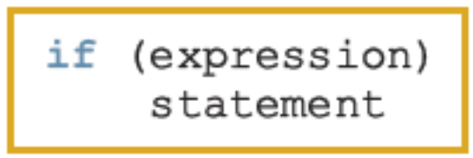
One-Way Selection
The syntax of one-way selection is:
The statement is executed if the value of the expression is true
The statement is bypassed if the value is false; program goes to the next statement
if is a reserved word
C++ Programming: From Problem Analysis to Program Design, Fourth Edition

Slide 31
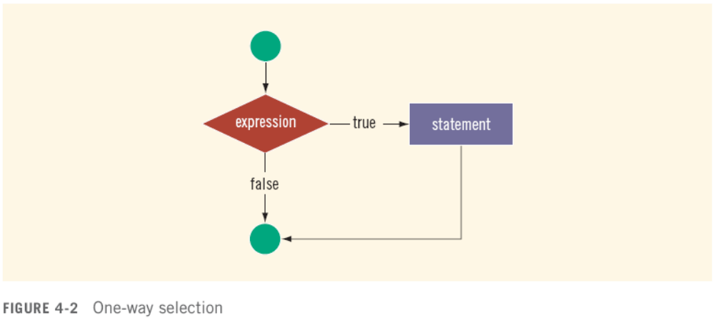
One-Way Selection (continued)
C++ Programming: From Problem Analysis to Program Design, Fourth Edition

Slide 32
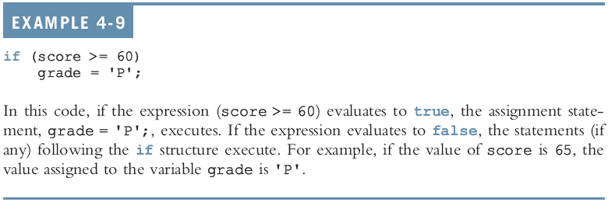
One-Way Selection (continued)
C++ Programming: From Problem Analysis to Program Design, Fourth Edition

Slide 33
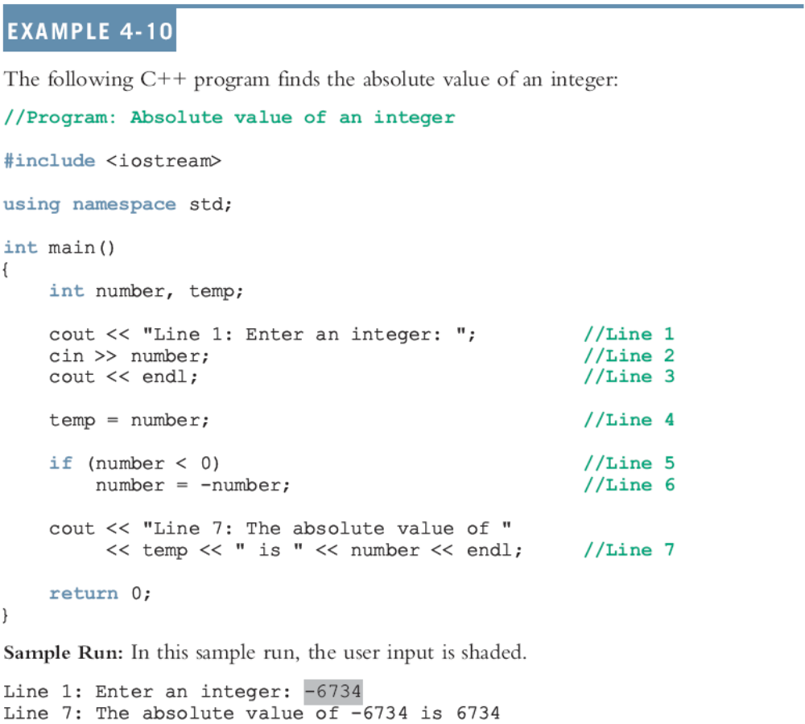

Slide 34
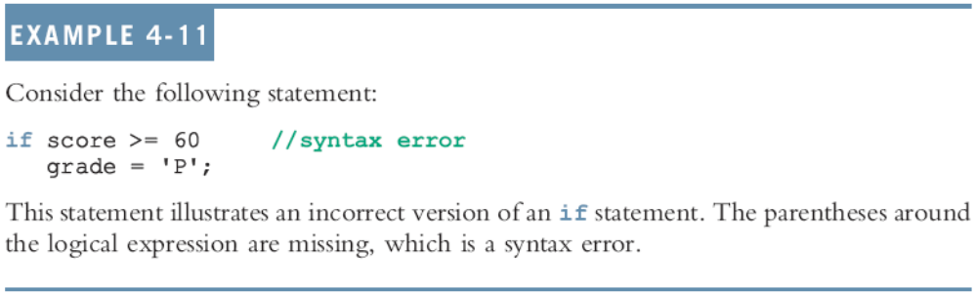
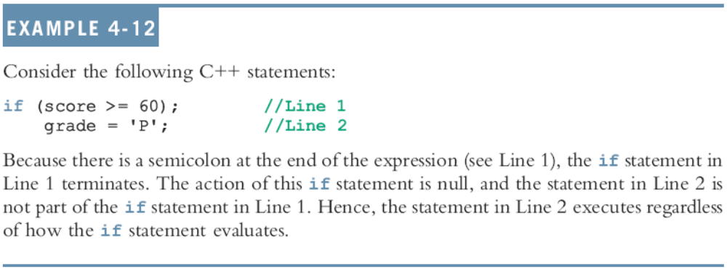
One-Way Selection (continued)
C++ Programming: From Problem Analysis to Program Design, Fourth Edition

Slide 35
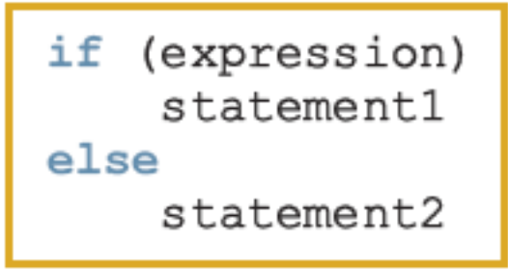
Two-Way Selection
Two-way selection takes the form:
If expression is true, statement1 is executed; otherwise, statement2 is executed
  statement1 and statement2 are any C++ statements
else is a reserved word
C++ Programming: From Problem Analysis to Program Design, Fourth Edition

Slide 36
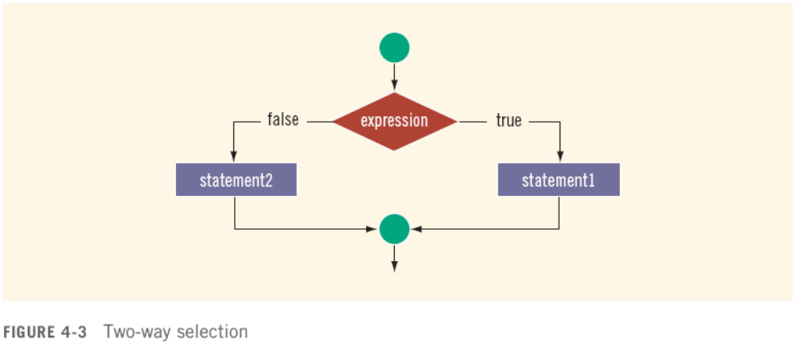
Two-Way Selection (continued)
C++ Programming: From Problem Analysis to Program Design, Fourth Edition

Slide 37
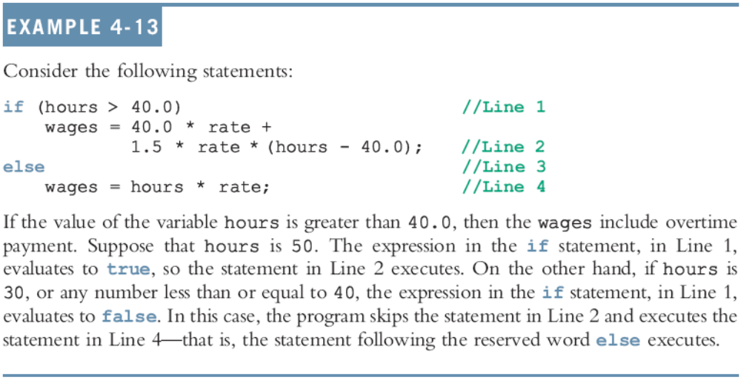
Two-Way Selection (continued)
C++ Programming: From Problem Analysis to Program Design, Fourth Edition

Slide 38
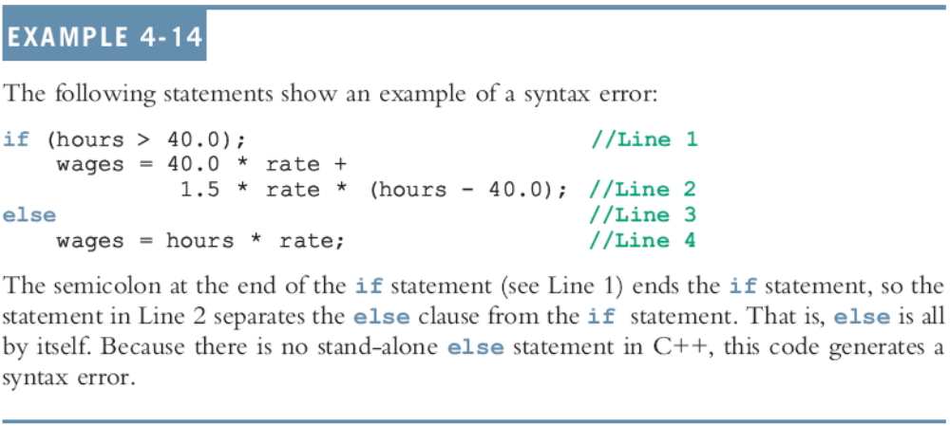
Two-Way Selection (continued)
C++ Programming: From Problem Analysis to Program Design, Fourth Edition

Slide 39
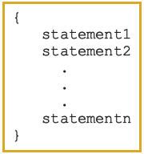
Compound (Block of) Statement
Compound statement (block of statements):
A compound statement is a single statement
C++ Programming: From Problem Analysis to Program Design, Fourth Edition

Slide 40
Compound (Block of) Statement (continued)
if (age > 18)
{
cout << "Eligible to vote." << endl;
cout << "No longer a minor." << endl;
}
else
{
cout << "Not eligible to vote." << endl;
cout << "Still a minor." << endl;
}
C++ Programming: From Problem Analysis to Program Design, Fourth Edition

Slide 41
Multiple Selections: Nested if
Nesting: one control statement in another
An else is associated with the most recent if that has not been paired with an else
C++ Programming: From Problem Analysis to Program Design, Fourth Edition

Slide 42
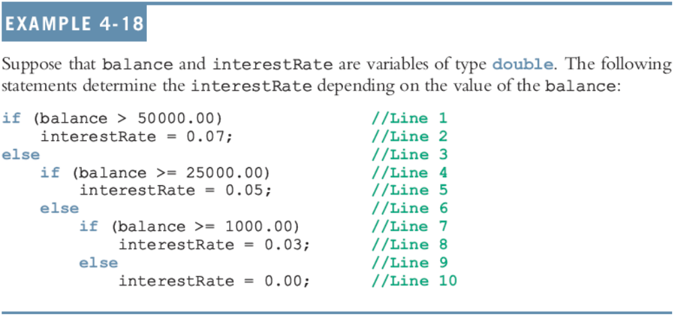
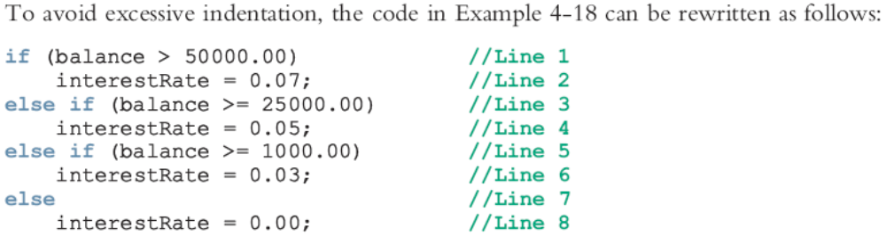

Slide 43
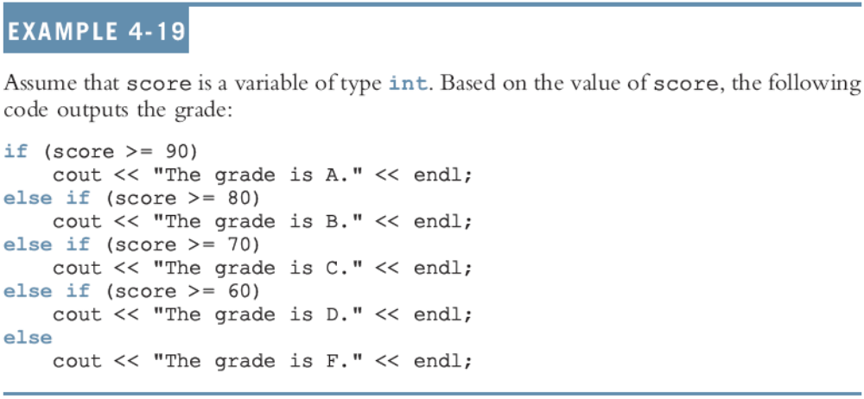
Multiple Selections: Nested if (continued)
C++ Programming: From Problem Analysis to Program Design, Fourth Edition

Slide 44
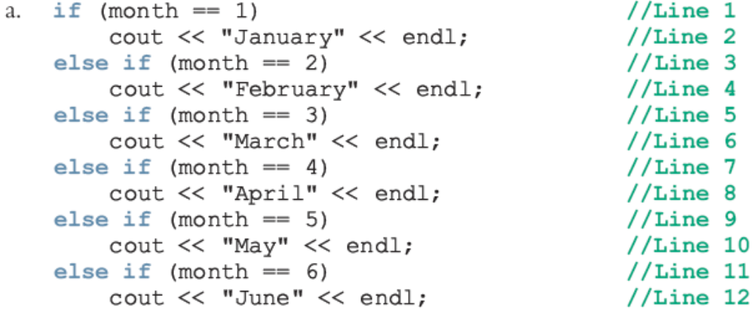
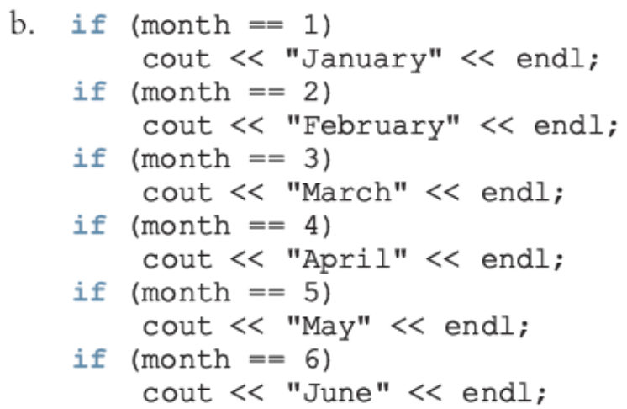
Comparing if…else Statements with a Series of if Statements
C++ Programming: From Problem Analysis to Program Design, Fourth Edition

Slide 45
Using Pseudocode to Develop, Test, and Debug a Program
Pseudocode (pseudo): provides a useful means to outline and refine a program before putting it into formal C++ code
You must first develop a program using paper and pencil
On paper, it is easier to spot errors and improve the program
  Especially with large programs
C++ Programming: From Problem Analysis to Program Design, Fourth Edition

Slide 46
Input Failure and the if Statement
If input stream enters a fail state
  All subsequent input statements associated with that stream are ignored
  Program continues to execute
  May produce erroneous results
Can use if statements to check status of input stream
If stream enters the fail state, include instructions that stop program execution
C++ Programming: From Problem Analysis to Program Design, Fourth Edition

Slide 47
Confusion Between == and =
C++ allows you to use any expression that can be evaluated to either true or false as an expression in the if statement:
  if (x = 5)
  cout << "The value is five." << endl;
The appearance of = in place of == resembles a silent killer
  It is not a syntax error
  It is a logical error
C++ Programming: From Problem Analysis to Program Design, Fourth Edition

Slide 48
Conditional Operator (?:)
Conditional operator (?:) takes three arguments
  Ternary operator
Syntax for using the conditional operator:
expression1 ? expression2 : expression3
If expression1 is true, the result of the conditional expression is expression2
  Otherwise, the result is expression3
C++ Programming: From Problem Analysis to Program Design, Fourth Edition

Slide 49
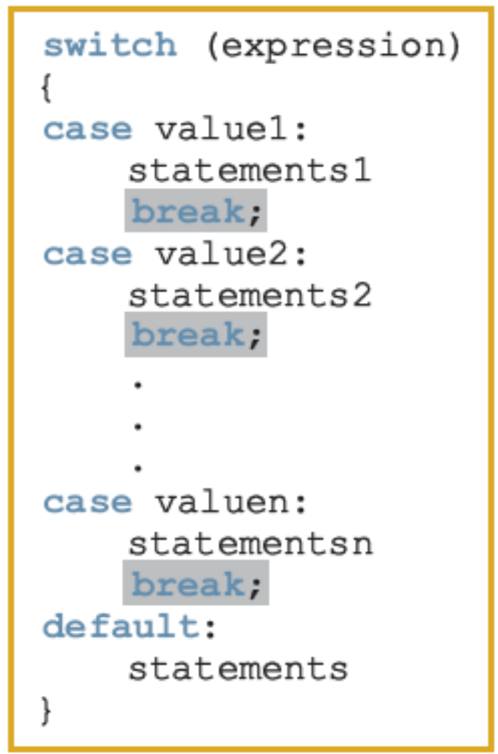
switch Structures
switch structure: alternate to if-else
switch (integral) expression is evaluated first
Value of the expression determines which corresponding action is taken
Expression is sometimes called the selector
C++ Programming: From Problem Analysis to Program Design, Fourth Edition

Slide 50
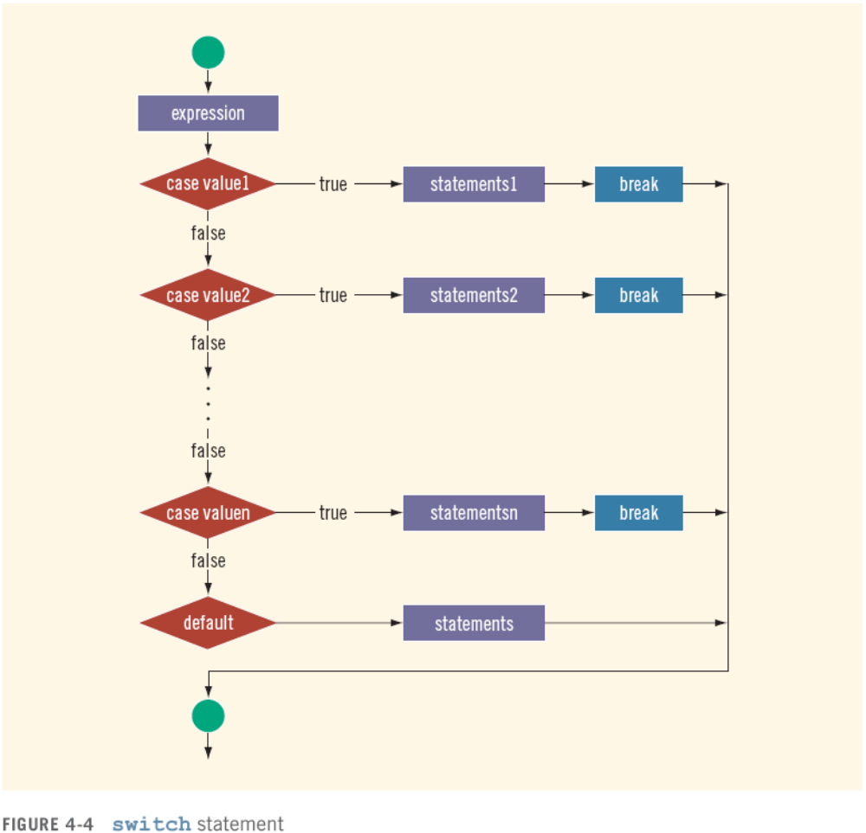

Slide 51
switch Structures (continued)
One or more statements may follow a case label
Braces are not needed to turn multiple statements into a single compound statement
The break statement may or may not appear after each statement
switch, case, break, and default are reserved words
C++ Programming: From Problem Analysis to Program Design, Fourth Edition

Slide 52
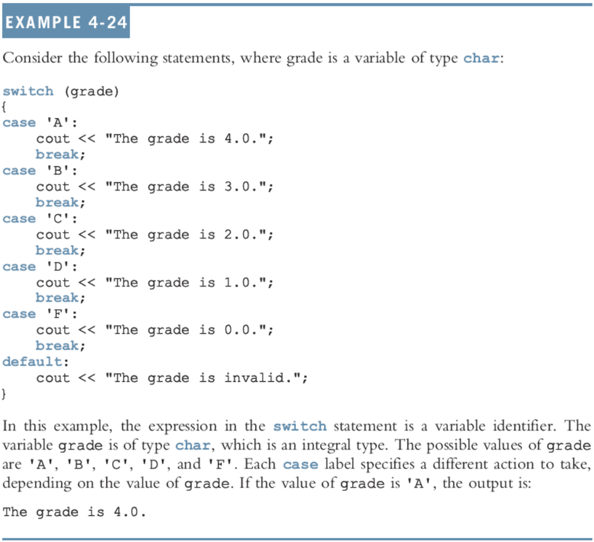

Slide 53
Terminating a Program with the assert Function
Certain types of errors that are very difficult to catch can occur in a program
  Example: division by zero can be difficult to catch using any of the programming techniques examined so far
The predefined function, assert, is useful in stopping program execution when certain elusive errors occur
C++ Programming: From Problem Analysis to Program Design, Fourth Edition

Slide 54

The assert Function (continued)
Syntax:
expression is any logical expression
If expression evaluates to true, the next statement executes
If expression evaluates to false, the program terminates and indicates where in the program the error occurred
To use assert, include cassert header file
C++ Programming: From Problem Analysis to Program Design, Fourth Edition

Slide 55
The assert Function (continued)
assert is useful for enforcing programming constraints during program development
After developing and testing a program, remove or disable assert statements
The preprocessor directive #define NDEBUG must be placed before the directive #include <cassert> to disable the assert statement
C++ Programming: From Problem Analysis to Program Design, Fourth Edition

Slide 56
Programming Example: Cable Company Billing
This programming example calculates a customer’s bill for a local cable company
There are two types of customers:
  Residential
  Business
Two rates for calculating a cable bill:
  One for residential customers
  One for business customers
C++ Programming: From Problem Analysis to Program Design, Fourth Edition

Slide 57
Programming Example: Rates
For residential customer:
  Bill processing fee: $4.50
  Basic service fee: $20.50
  Premium channel: $7.50 per channel
For business customer:
  Bill processing fee: $15.00
  Basic service fee: $75.00 for first 10 connections and $5.00 for each additional connection
  Premium channel cost: $50.00 per channel for any number of connections
C++ Programming: From Problem Analysis to Program Design, Fourth Edition

Slide 58
Programming Example: Requirements
Ask user for account number and customer code
Assume R or r stands for residential customer and B or b stands for business customer
C++ Programming: From Problem Analysis to Program Design, Fourth Edition

Slide 59
Programming Example: Input and Output
Input:
  Customer account number
  Customer code
  Number of premium channels
  For business customers, number of basic service connections
Output:
  Customer’s account number
  Billing amount
C++ Programming: From Problem Analysis to Program Design, Fourth Edition

Slide 60
Programming Example: Program Analysis
Purpose: calculate and print billing amount
Calculating billing amount requires:
  Customer for whom the billing amount is calculated (residential or business)
  Number of premium channels to which the customer subscribes
For a business customer, you need:
  Number of basic service connections
  Number of premium channels
C++ Programming: From Problem Analysis to Program Design, Fourth Edition

Slide 61
Programming Example: Program Analysis (continued)
Data needed to calculate the bill, such as bill processing fees and the cost of a premium channel, are known quantities
The program should print the billing amount to two decimal places
C++ Programming: From Problem Analysis to Program Design, Fourth Edition

Slide 62
Programming Example: Algorithm Design
Set precision to two decimal places
Prompt user for account number and customer type
If customer type is R or r
  Prompt user for number of premium channels
  Compute and print the bill
If customer type is B or b
  Prompt user for number of basic service connections and number of premium channels
  Compute and print the bill
C++ Programming: From Problem Analysis to Program Design, Fourth Edition

Slide 63
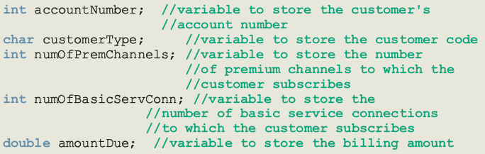
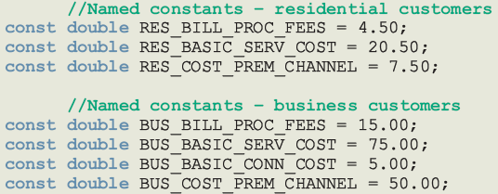
Programming Example: Variables and Named Constants
C++ Programming: From Problem Analysis to Program Design, Fourth Edition

Slide 64
Programming Example: Formulas
Billing for residential customers:
amountDue = RES_BILL_PROC_FEES +
RES_BASIC_SERV_COST
+ numOfPremChannels *
RES_COST_PREM_CHANNEL;
C++ Programming: From Problem Analysis to Program Design, Fourth Edition

Slide 65
Programming Example: Formulas (continued)
Billing for business customers:
if (numOfBasicServConn <= 10)
amountDue = BUS_BILL_PROC_FEES +
BUS_BASIC_SERV_COST
+ numOfPremChannels *
BUS_COST_PREM_CHANNEL;
else
amountDue = BUS_BILL_PROC_FEES +
BUS_BASIC_SERV_COST
+ (numOfBasicServConn - 10)
* BUS_BASIC_CONN_COST
+ numOfPremChannels *
BUS_COST_PREM_CHANNEL;
C++ Programming: From Problem Analysis to Program Design, Fourth Edition

Slide 66
Programming Example: Main Algorithm
Output floating-point numbers in fixed decimal with decimal point and trailing zeros
  Output floating-point numbers with two decimal places and set the precision to two decimal places
Prompt user to enter account number
Get customer account number
Prompt user to enter customer code
Get customer code
C++ Programming: From Problem Analysis to Program Design, Fourth Edition

Slide 67
Programming Example: Main Algorithm (continued)
If the customer code is r or R,
  Prompt user to enter number of premium channels
  Get the number of premium channels
  Calculate the billing amount
  Print account number and billing amount
C++ Programming: From Problem Analysis to Program Design, Fourth Edition

Slide 68
Programming Example: Main Algorithm (continued)
If customer code is b or B,
  Prompt user to enter number of basic service connections
  Get number of basic service connections
  Prompt user to enter number of premium channels
  Get number of premium channels
  Calculate billing amount
  Print account number and billing amount
C++ Programming: From Problem Analysis to Program Design, Fourth Edition

Slide 69
Programming Example: Main Algorithm (continued)
If customer code is other than r, R, b, or B, output an error message
C++ Programming: From Problem Analysis to Program Design, Fourth Edition

Slide 70
Summary
Control structures alter normal control flow
Most common control structures are selection and repetition
Relational operators: ==, <, <=, >, >=, !=
Logical expressions evaluate to 1 (true) or 0 (false)
Logical operators: ! (not), && (and), || (or)
C++ Programming: From Problem Analysis to Program Design, Fourth Edition

Slide 71
Summary (continued)
Two selection structures: one-way selection and two-way selection
The expression in an if or if...else structure is usually a logical expression
No stand-alone else statement in C++
  Every else has a related if
A sequence of statements enclosed between braces, { and }, is called a compound statement or block of statements
C++ Programming: From Problem Analysis to Program Design, Fourth Edition

Slide 72
Summary (continued)
Using assignment in place of the equality operator creates a semantic error
switch structure handles multiway selection
break statement ends switch statement
Use assert to terminate a program if certain conditions are not met
C++ Programming: From Problem Analysis to Program Design, Fourth Edition

